Slide 1




SUBJECT: PROGRAMMING IN JAVA
SEMESTER: 3rd Semester BCA
1
JAIN UNIVERSITY BCA

Slide 2
What is Constructor in Java?
Constructor is a special method that is used to initialize a newly created object and is called just after the memory is allocated for the object.
It can be used to initialize the objects to desired values or default values at the time of object creation.
Rules for creating a Java Constructor
It has the same name as the class
It should not return a value not even void

Slide 3





class Circle
{
double x,y;
double r;
double circumference()
{
return 2*3.14159*r;
}
double area()
{
return(22/7)*r*r;
}
Circle(double a, double b, double c)
{
x = a; y = b; r = c;
}
}

Slide 4

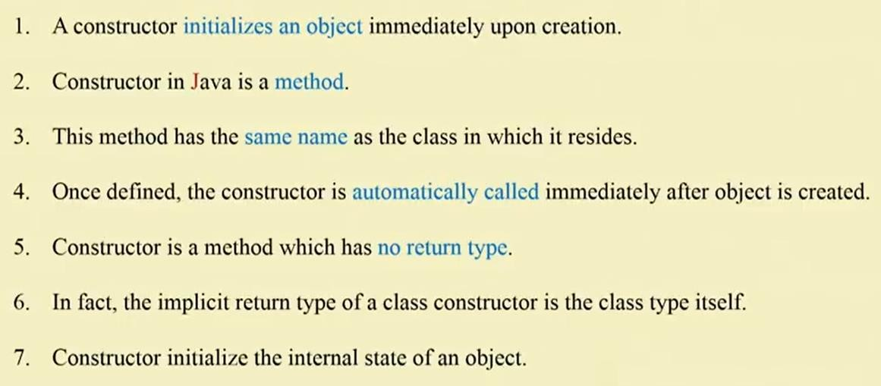

Slide 5

Sometimes , it is necessary to initialize an object in a number of ways.
Java allows this using the concept of Constructor Overloading.
In other words, Java allows to declare one or more constructor method with different lists of parameters and different method definition.

Slide 6
To understand Constructor Overloading in Java
class Demo
{
int value1;
int value2;
Demo(int a)
{
value1 = a;
System.out.println("Inside 2nd Constructor");
}
Demo(int a,int b)
{
value1 = a;
value2 = b;
System.out.println("Inside 3rd Constructor");
}
public void display()
{
System.out.println("Value1 === "+value1);
System.out.println("Value2 === "+value2);
}

Slide 7
public static void main(String args[])
{
Demo d2 = new Demo(30);
Demo d3 = new Demo(30,40);
d2.display();
d3.display();
}
}

Slide 8
Mutator Methods (Setters):
Purpose: Mutator methods are used to modify the values of private fields in a class.
Naming Convention: Typically named with the prefix "set" followed by the name of the attribute they modify.
Parameters: They take a parameter representing the new value to set.
Return Type: They usually have a void return type, as they are primarily used to modify the internal state.
Example:
public class MyClass
{
private int myNumber;
// Mutator method for myNumber
public void set myNumber(int newValue)
{ myNumber = newValue;
}
};

Slide 9
public class Student
{
// Private fields
private String name;
private int age;
// Accessor method for the name field
public String getname()
{
return name;
} // Mutator method for the name field
public void setname(String newName)
{
name = newName;
} // Mutator method for the age field
public void setage(int newAge)
{
age = newAge;
}

Slide 10
// Display method to print student information
public void displayStudentInfo()
{
System.out.println("Student Name: " + name);
System.out.println("Student Age: " + age);
}
public static void main(String[] args)
{ // Create an instance of the Student class Student
student1 = new Student();
// Use mutator methods to set values
student1.setname("Alice");
student1.setage(20);
// Use accessor methods to retrieve values
System.out.println("Name: " + student1.getname());
System.out.println("Age: " + student1.getage());
// Display student information using a method
student1.displayStudentInfo();
}
}

Slide 11
In this example, the Student class has private fields name and age. It provides accessor methods (getName and getAge) to retrieve the values of these fields and mutator methods (setName and setAge) to set new values.

Slide 12


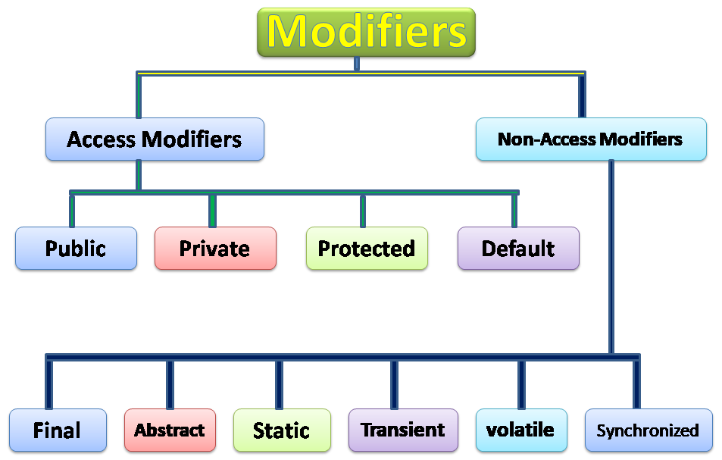
JAIN UNIVERSITY BCA
30

Slide 13
Accessor methods and mutator methods,
often referred to as getters and setters, are two types of methods commonly used in object-oriented programming to access and modify the private fields of a class.
Accessor Methods (Getters):
Purpose: Accessor methods are used to retrieve the values of private fields (attributes) in a class.
Naming Convention: Typically named with the prefix "get" followed by the name of the attribute they retrieve.
Return Type: They return the value of the attribute.
Example:
public class MyClass
{
private int myNumber;
// Accessor method for myNumber
public int getmyNumber()
{
return myNumber;
}
}

Slide 14


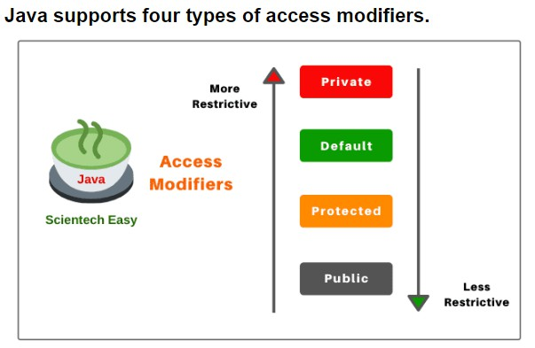


access specifiers are those modifiers that are used to restrict the visibility / accessibility of classes, fields, methods, or constructors.
The access specifiers
are also known as visibility modifiers
JAIN UNIVERSITY BCA
31

Slide 15

Private: The access level of a private modifier is only within the class. It cannot be accessed from outside the class.
Default: The access level of a default modifier is only within the package. It cannot be accessed from outside the package. If you do not specify any access level, it will be the default.
Protected: The access level of a protected modifier is within the package and outside the package through child class. If you do not make the child class, it cannot be accessed from outside the package.
Public: The access level of a public modifier is everywhere. It can be accessed from within the class, outside the class, within the package and outside the package.

Slide 16


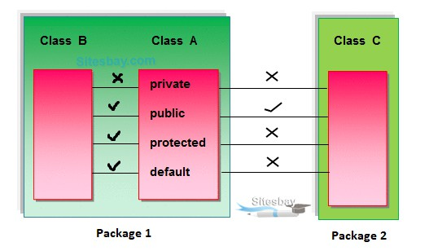


Slide 17

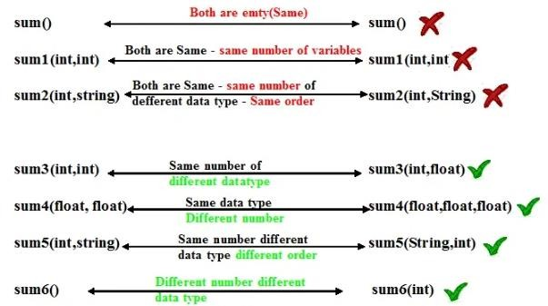
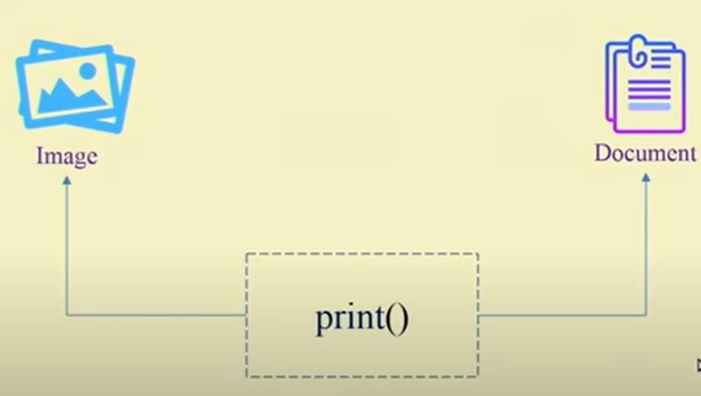

Slide 18


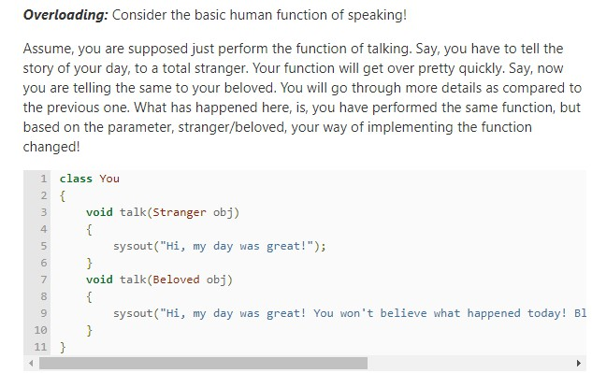

Slide 19
class Adder{
static int add(int a, int b)
{return a+b;
}
static double add(double a, double b)
{return a+b;
}
}
class TestOverloading2{
public static void main(String[] args){
System.out.println(Adder.add(11,11));
System.out.println(Adder.add(12.3,12.6));
}}

Slide 20






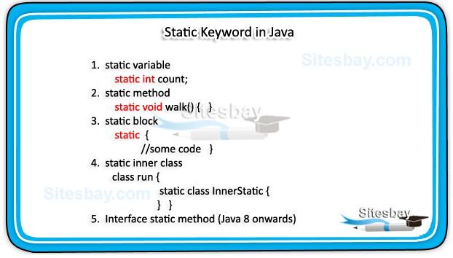
static is a non-access modifier in Java which is applicable for the following:
To create a static member (block,variable,method,nes ted class), precede its declaration with the keyword static. When a member is declared static, it can be accessed before any objects of its class are created, and without reference to any object.

Slide 21



If any variable we declared as static is known as static variable.
A Static variable is used to fulfill the common requirement.
For Example the Company name of employees, the college name of students, etc. The Name of the college is common for all students.
The static variable allocates memory only once in the class area at the time of class loading.
Advantage of static variable
Using a static variable we make our program memory efficient (i.e it saves memory).

Slide 22



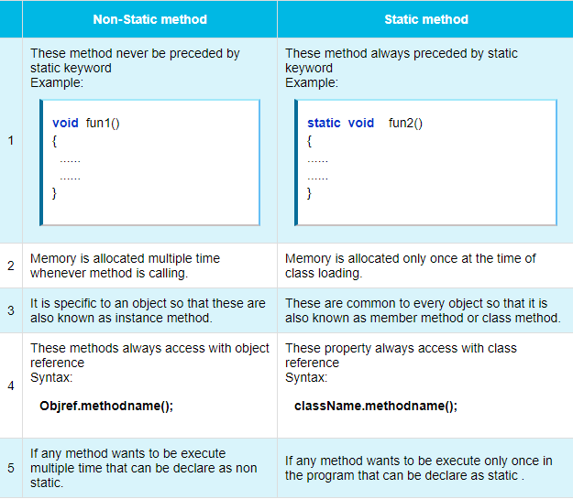

Slide 23







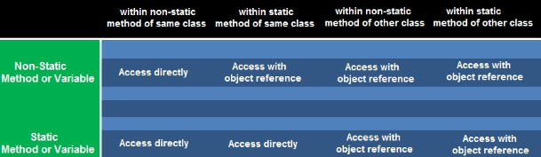
Following table represent how the static and non-static properties are accessed in the different static or non-static method of same class or other class.

